Slide 1
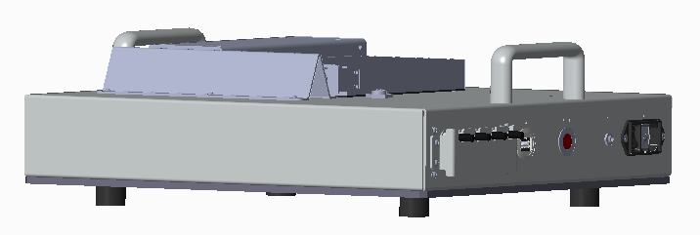
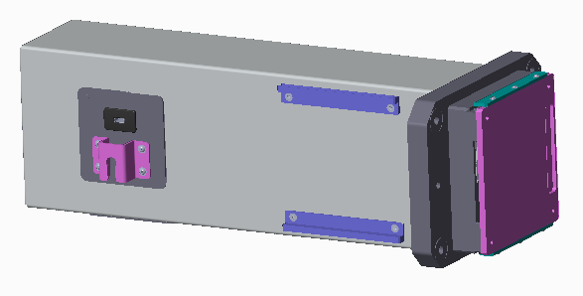
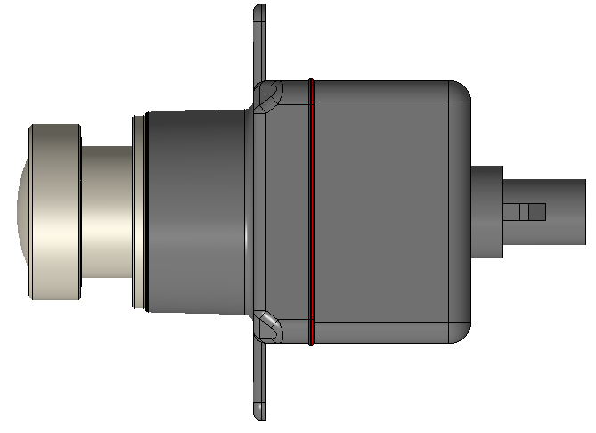
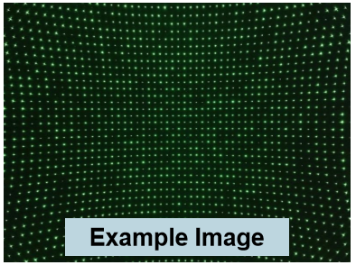
Falcon/Eagle LGIT | Tesseract
System Overview
Camera calibration tool (Single mode green laser source +
2D beam splitting diffractive optical instrument)
532nm (green) nominal wavelength
Laser safety Class 1 compliant
Illuminator optics project an infinite conjugate spot pattern
Illuminator description:
50mm clear aperture
Diffractive pattern will cover > 130° DFOV
WD depends on module FOV
Model | Eagle (NFOV) | Falcon (MFOV)
Expected Max WD (mm) | >50mm | ~23mm
Laser Module
Hardware Quartus will provide:
4-Channel Laser Module
Illuminator module
Single mode fiber patch cable
FOV coverage > 130°
DUT FOV
Optic fiber
Illuminator
DUT
Socket
F/G
WD
Illuminator
DUT
Moving fixture
Mounting Plate
Hardware LGIT will provide:
Socket
Frame grabber
Fixture to move socket to illuminator
Enclosure (optional)
Standard calibration outputs:
Intrinsic parameters:
• Practical Focal Length (PFL) in x and y, units of pixels
• Principal point (PP) in x and y, units of pixels
• Distortion polynomial coefficients
Extrinsic parameters
• 3 Degree of Freedom (DOF) angular pose of camera relative to Illuminator.
Required initial conditions for model solver
• Nominal focal length (pixels)
Notes:
과거 이력, 실패 이유 등 확인

Slide 2
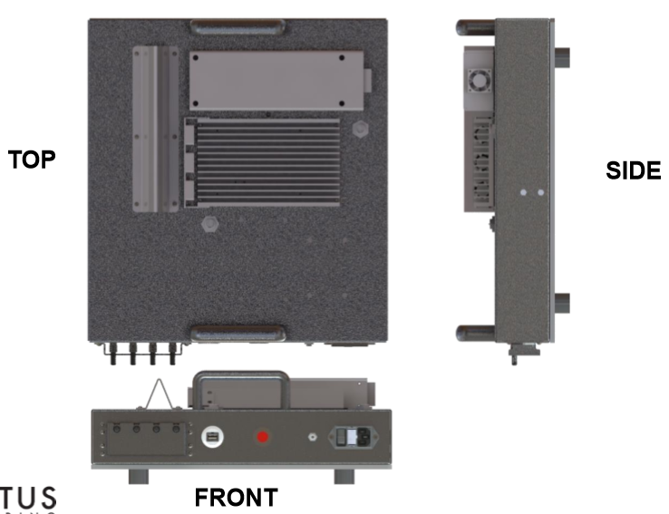
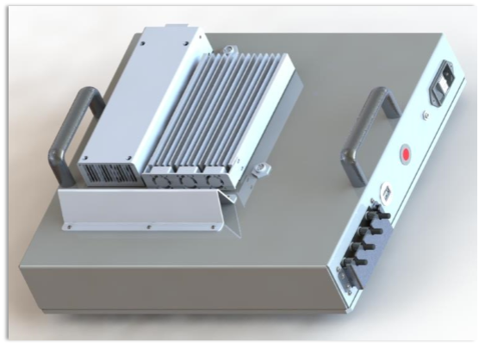
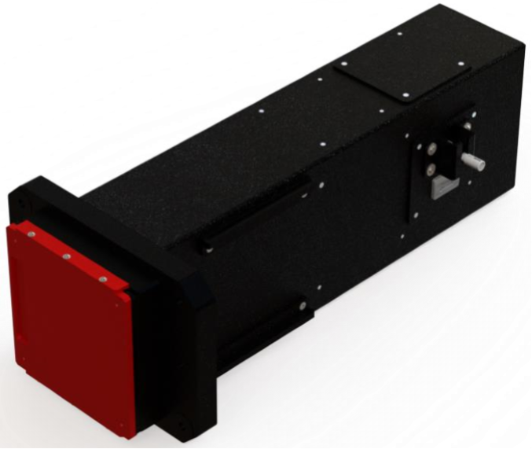
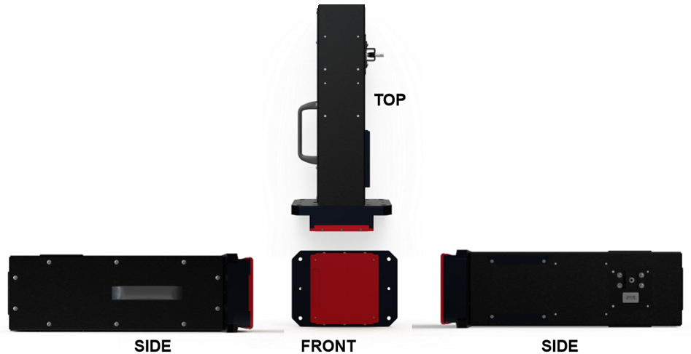
Falcon/Eagle LGIT | Tesseract
Hardware Details
Laser module (PN: Q5179-0160)
Net weight: 8.9kg
Dimension: 438mm X 380mm X 145mm
Specs:
- Supply 4 channels of light output
- 532nm (green light)
- FC/APC fiber output
- AC voltage input (100-250 VAC, 50/60Hz), 50W max power
- USB port for SW control and calibration storage
- Interlock input for safety switch
- Indicator LED
Accessories included: power cord, USB cord
Tesseract XLHD Illuminator (PN: Q5179-0050)
Net weight: 3.6kg
Dimension: 420mm X 185mm X 134mm
Specs:
- Optical test pattern generator for camera calibration
- FC/APC fiber output
- USB port for calibration storage
- Remove shipping cap after installed in fixture
Accessories included: FC/APC fiber optic patch cable, USB-C cord
Notes:
과거 이력, 실패 이유 등 확인

Slide 4
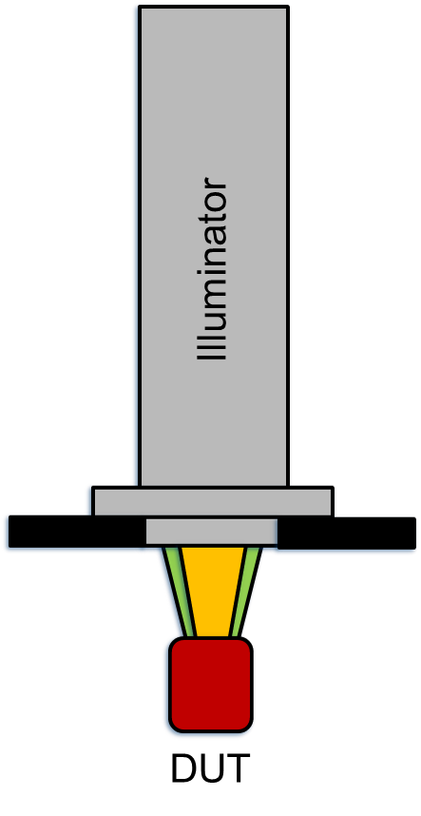
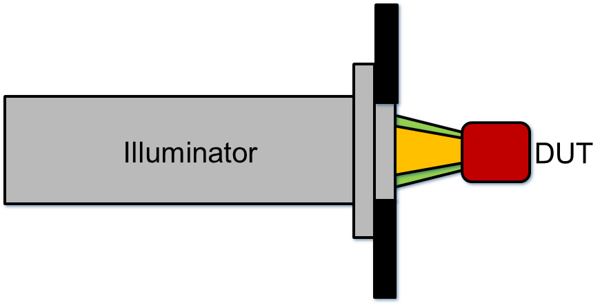
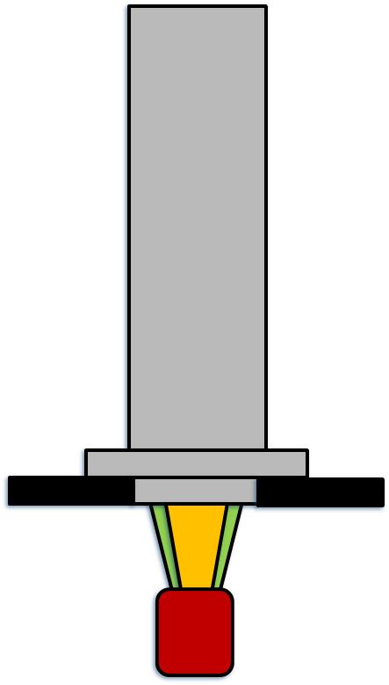
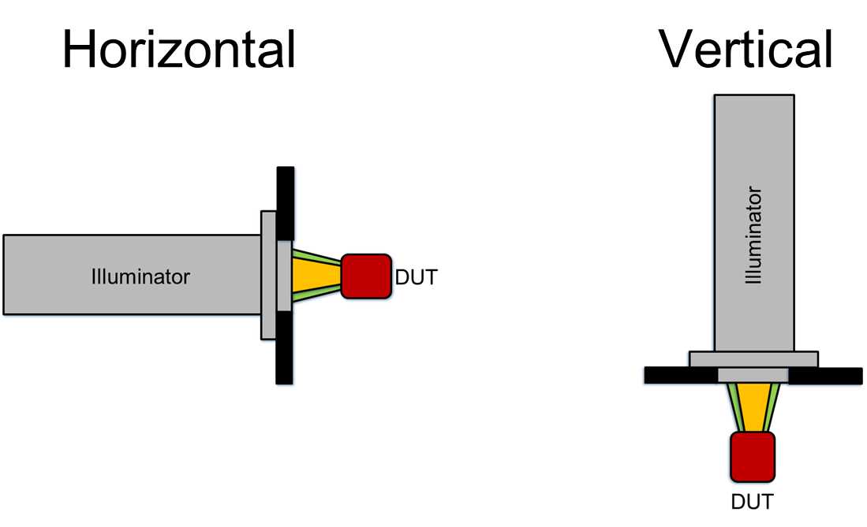
Horizontal
Vertical
Illuminator
DUT
Illuminator
DUT

